Slide 1


Slide 2
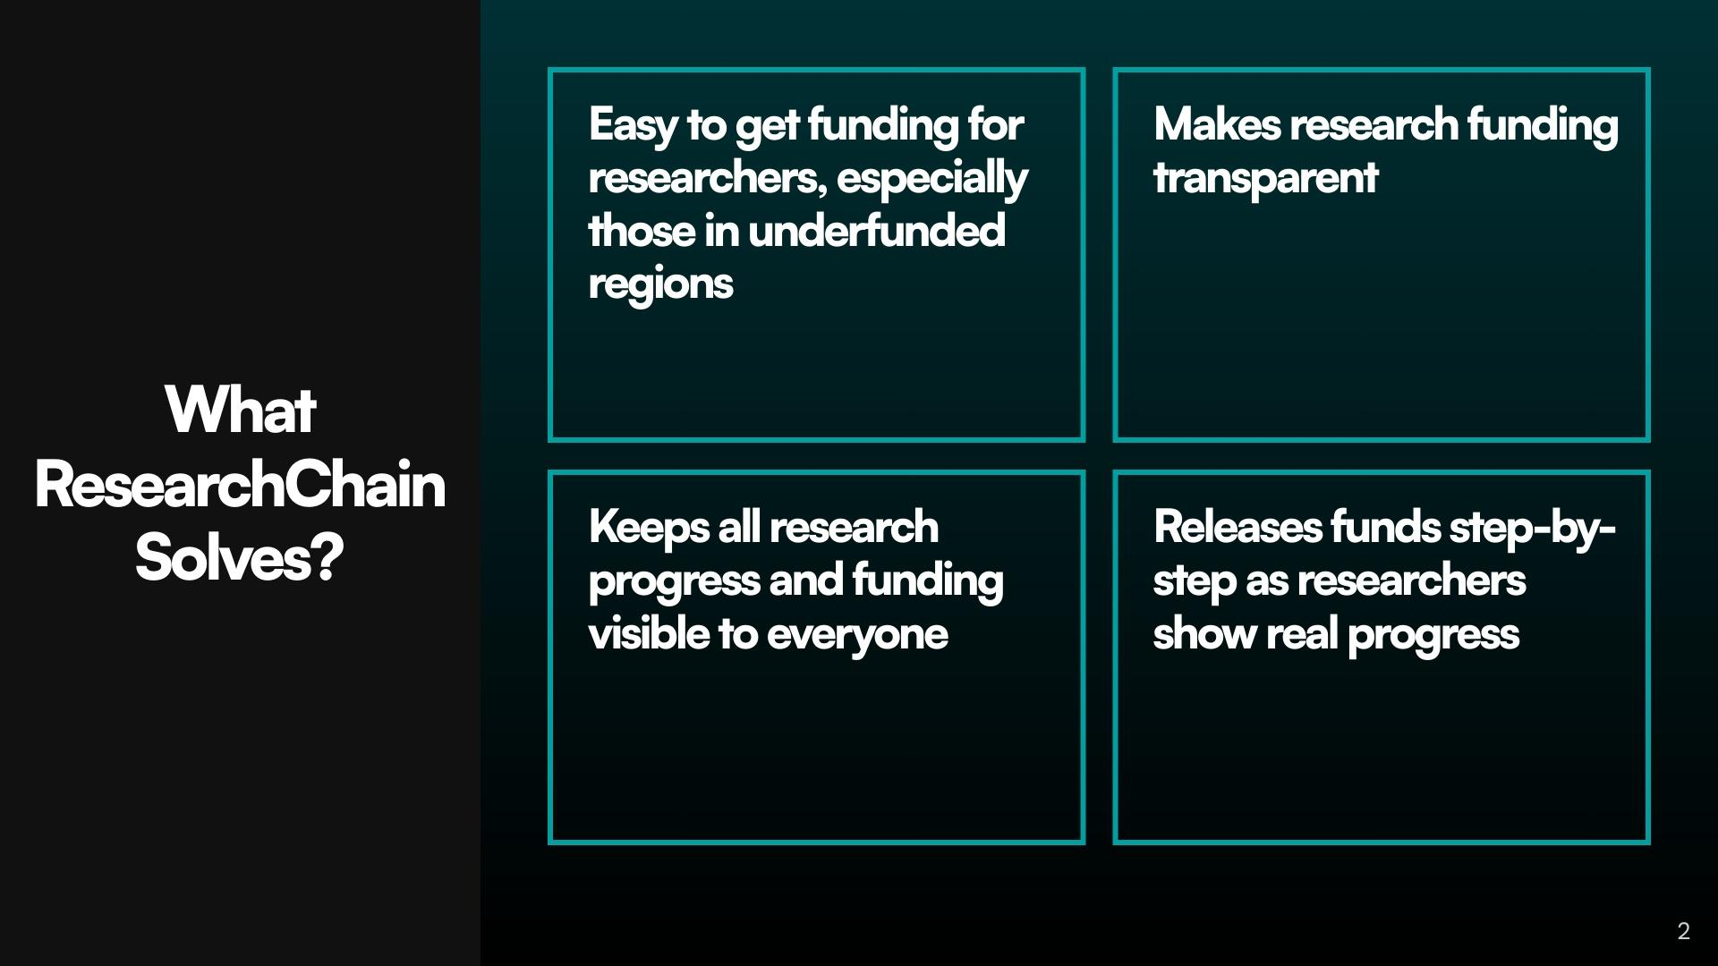

Slide 3
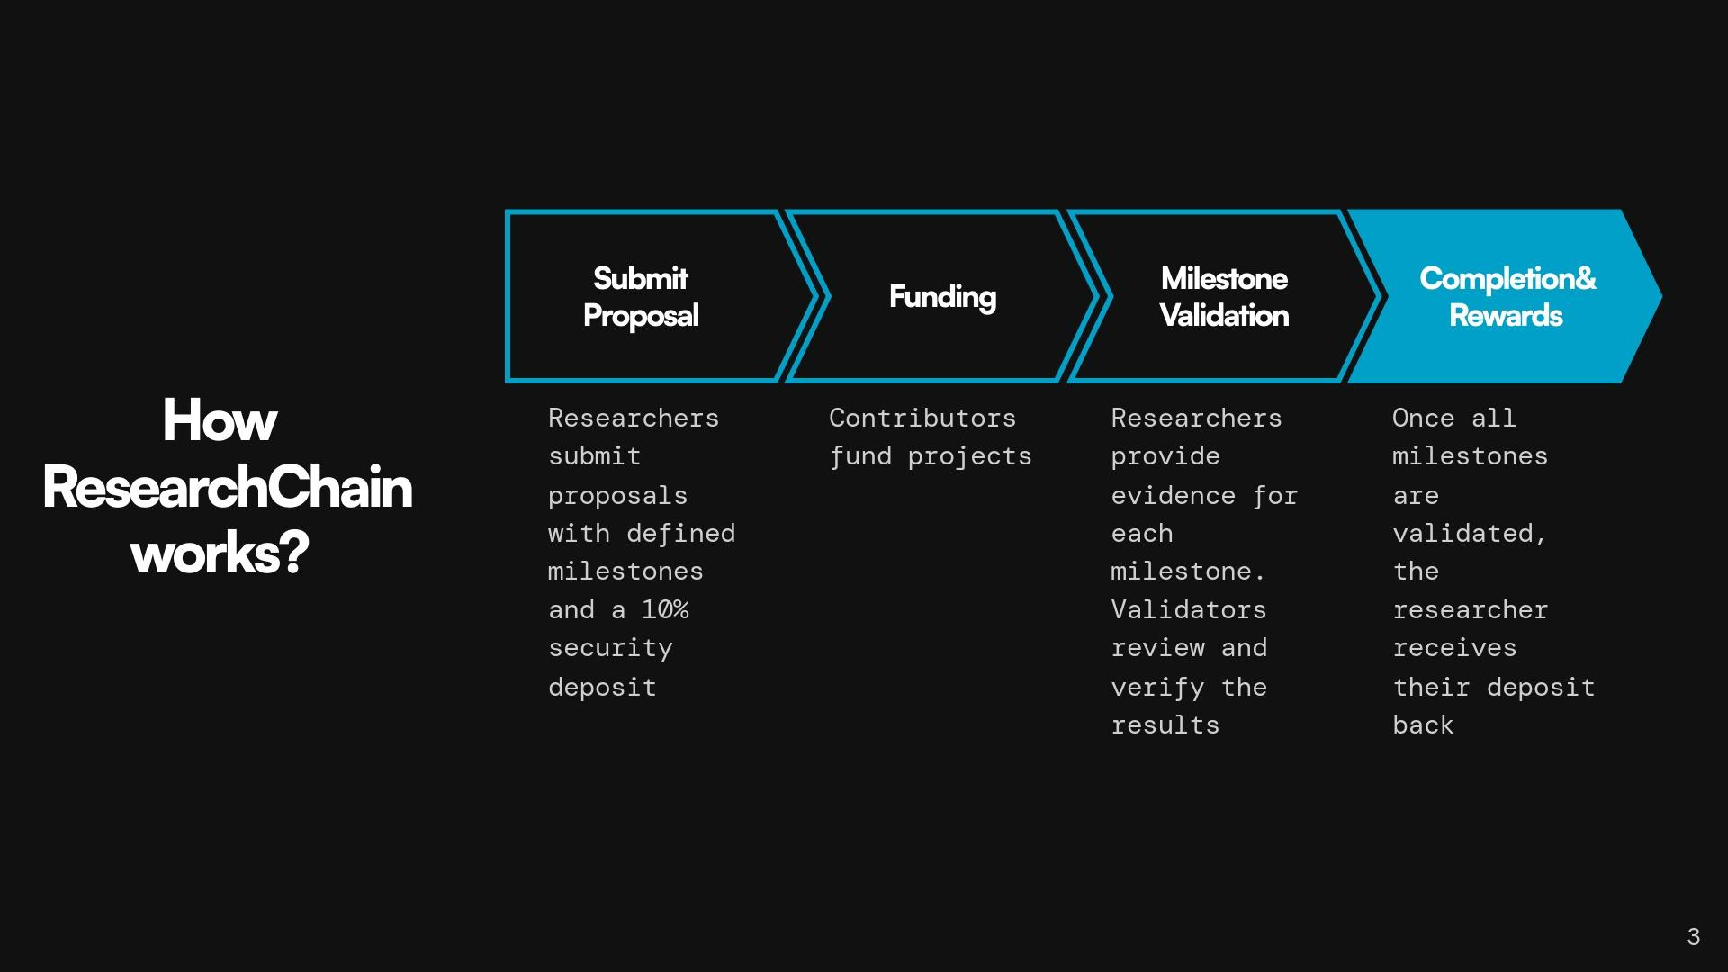
Notes:
Always Be Prioritizing Don't fall victim to "check-list" marketing. That is, don't feel compelled to create a giant list of all the marketing activities you can possibly execute. Hold on to the focus you established with your Big Goal and Growth Plan. Pick the 3 most important aspects of your marketing plan that will drive 80% of your results. Position these as your big levers. You will not be derailed from making them a success.

Slide 4
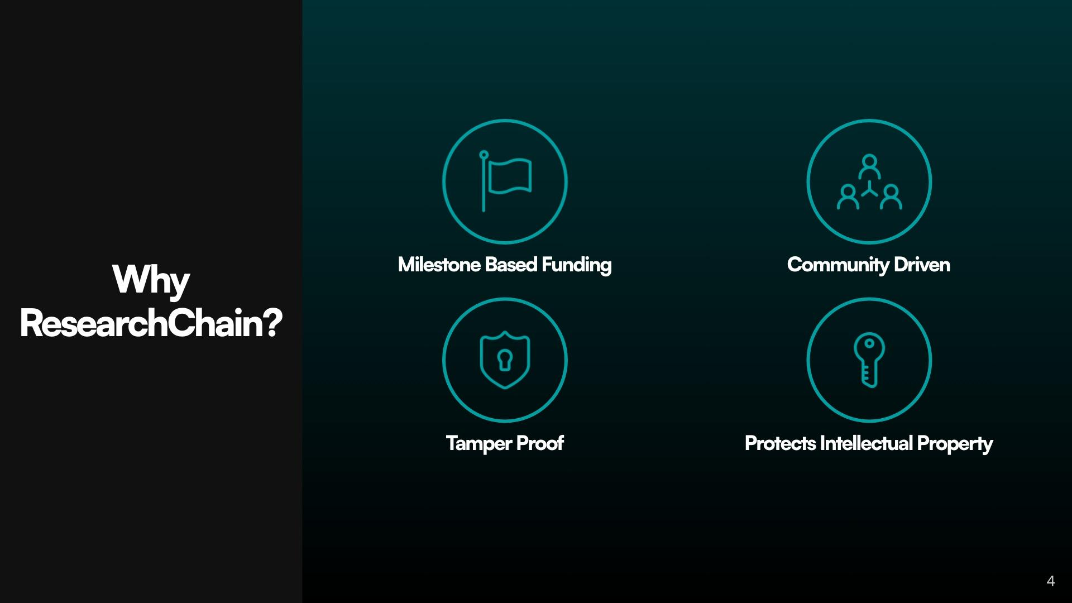

Slide 5


Slide 6
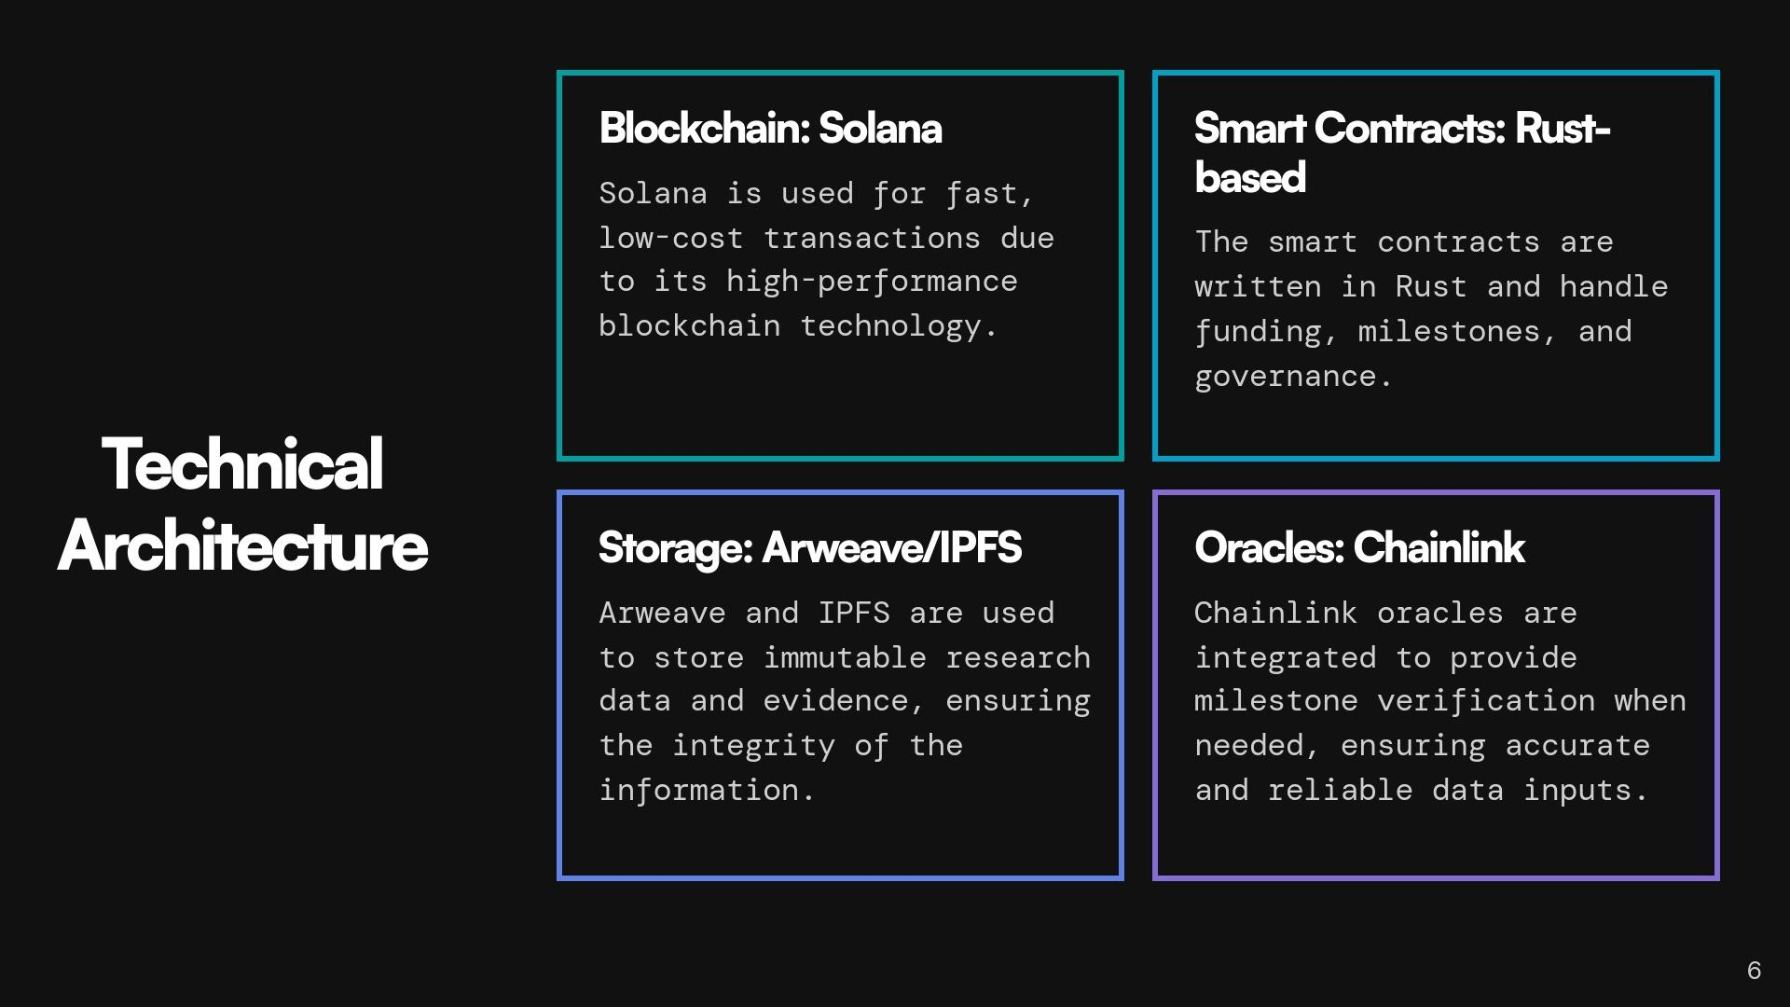

Slide 7
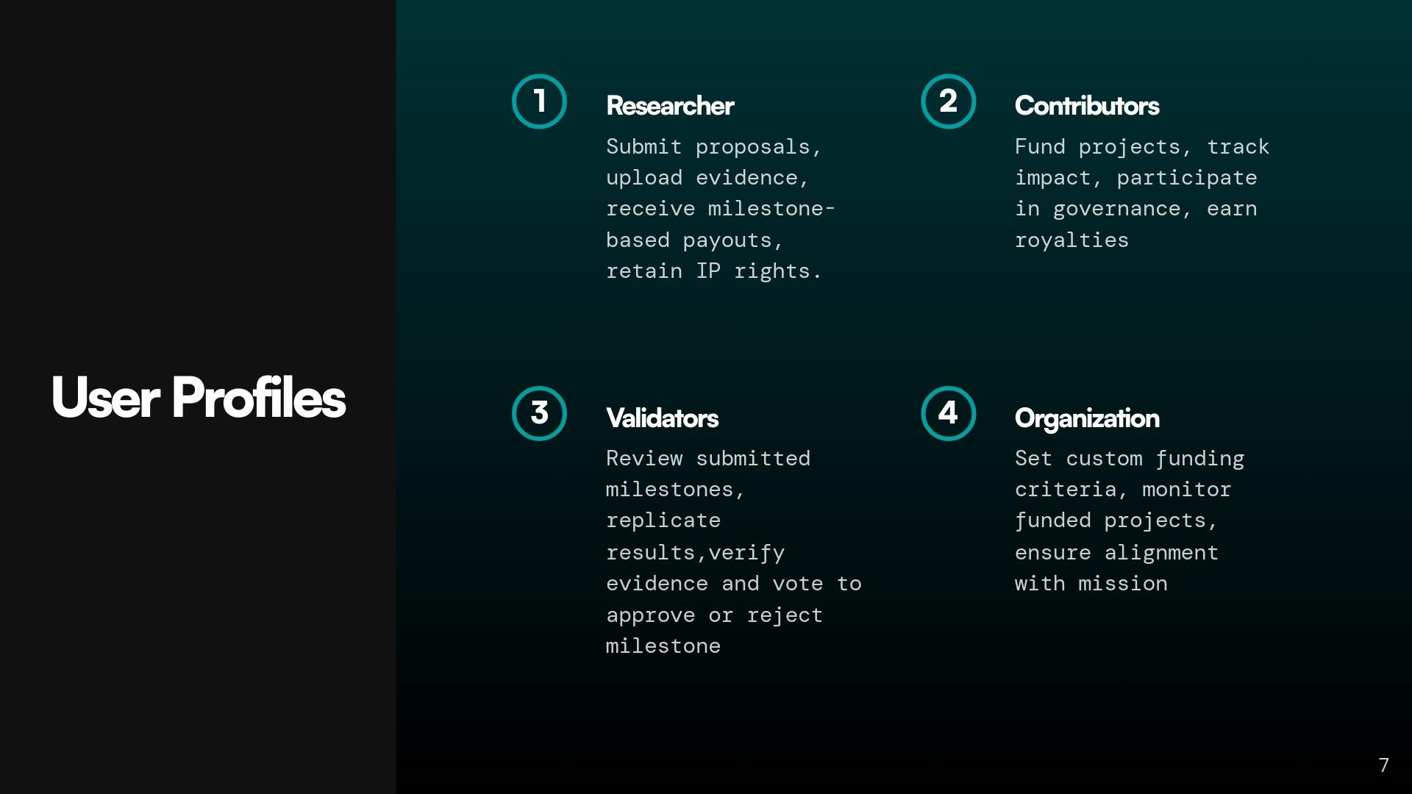

Slide 8
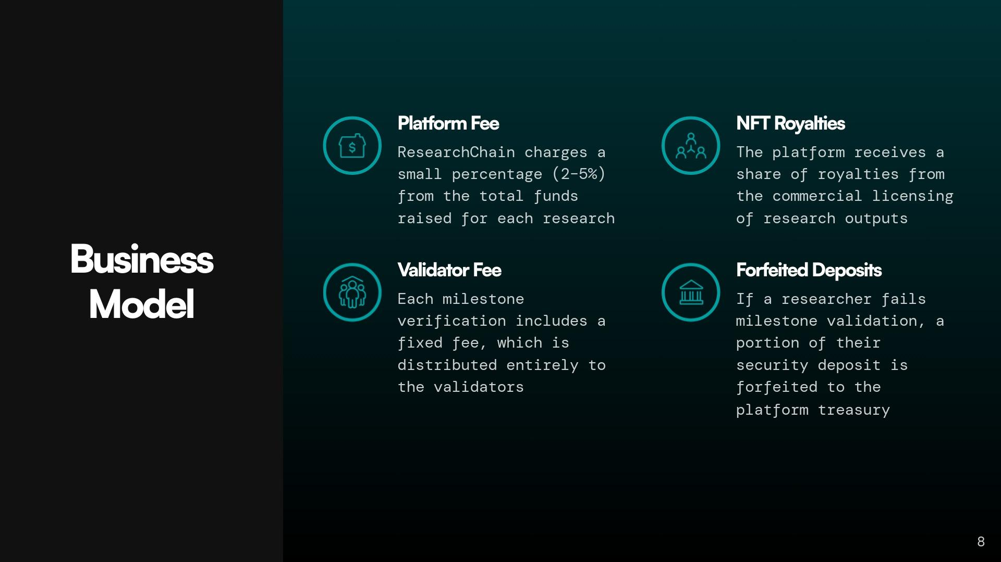

Slide 9
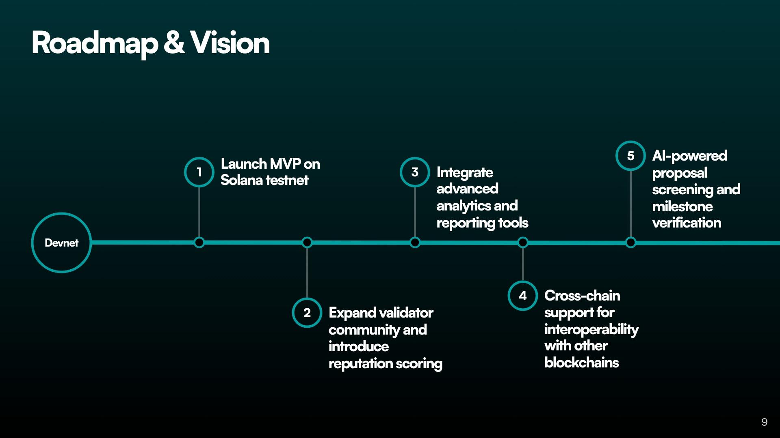

Slide 10

Follow me on X
Github
LinkedIn

